Slide 1
Java Servlet web application
-Using NetBEans
By Bijay shrestha (BscCsit/074/11)

Slide 2

Step: 1
Go to File>>New Project or Simply Ctrl+Shift+N to create a new project

Slide 3
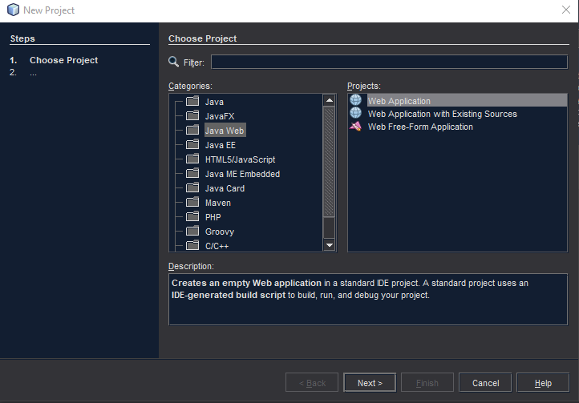
Step: 2
While choosing project, select Java Web and then Web Application

Slide 4
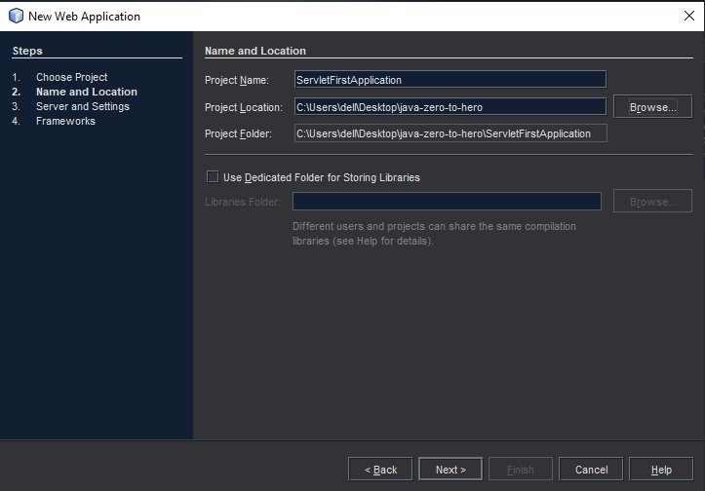
Step: 3
Give a project name and choose a folder location for the project

Slide 5
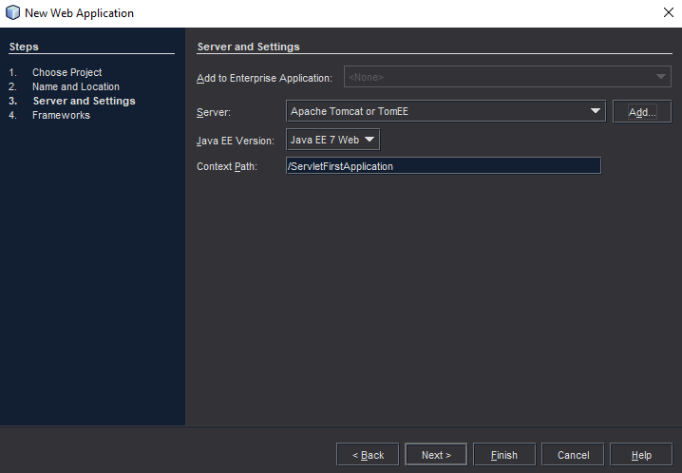
Step: 4
Choose Server “Apache Tomcat of TomEE” and click on Next

Slide 6
What if Tomcat is not Installed??
Download and Install Tomcat
Go to http://tomcat.apache.org and download apache-tomcat with version 10.
Unzip the download zip file to C:\tomcat.
Create an Environment variable called “JAVA_HOME”
Create an Environment variable called “JAVA_HOME” and set it to your JDK installed directory. Eg, set JAVA_HOME to “C:\Program Files\Java\jdk1.8.0_181”.
Also create an environment variable called “CATALINA_HOME” and set path as “C:\tomcat”.
Edit Path variable and add a new “%JAVA_HOME%\bin” and “%CATALINA_HOME%\bin”path.
Open cmd then navigate to “C:\tomcat\bin” then run startup to run tomcat server

Slide 7
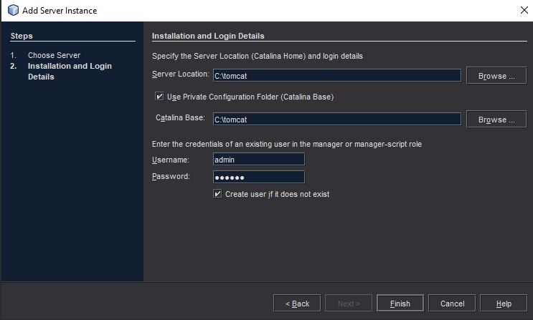
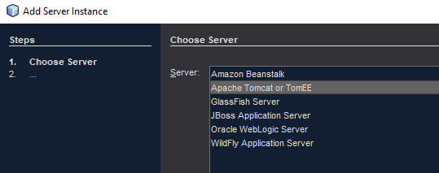
Add server instance

Slide 8
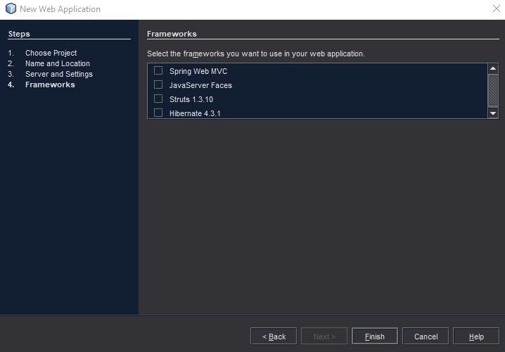
Step: 5
Select none of the frameworks and click on Finish.

Slide 9
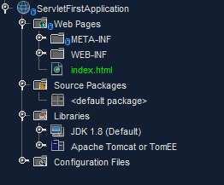
Successful project creation

Slide 10
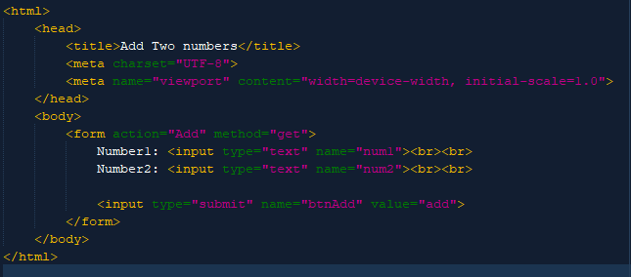
Step: 6
Edit the index.html as:

Slide 11
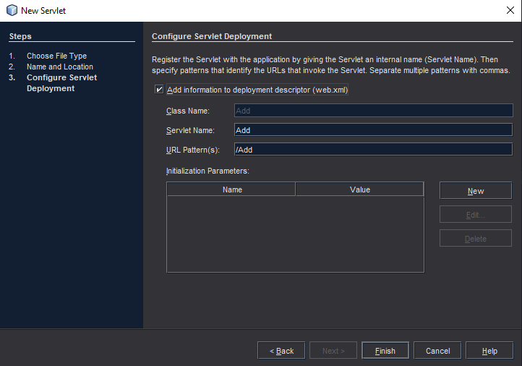
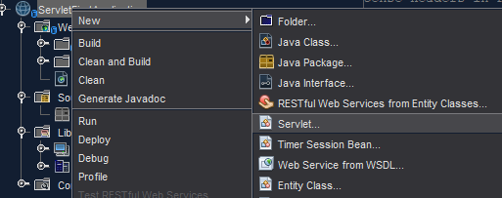
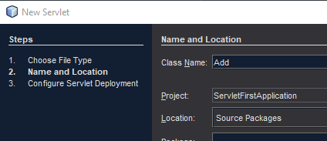
step: 7
Create a new servlet as:

Slide 12
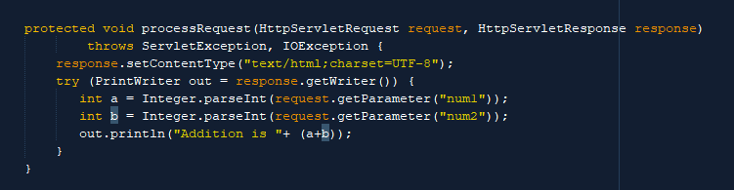
Step:8
Edit the Add.java file as:

Slide 13

Step:9
Now, you can run the web application by clicking the play button as:

Slide 14
Thank You

